Slide 1
Diabetes Analysis and Prediction
Ben Weisenburger

Slide 2
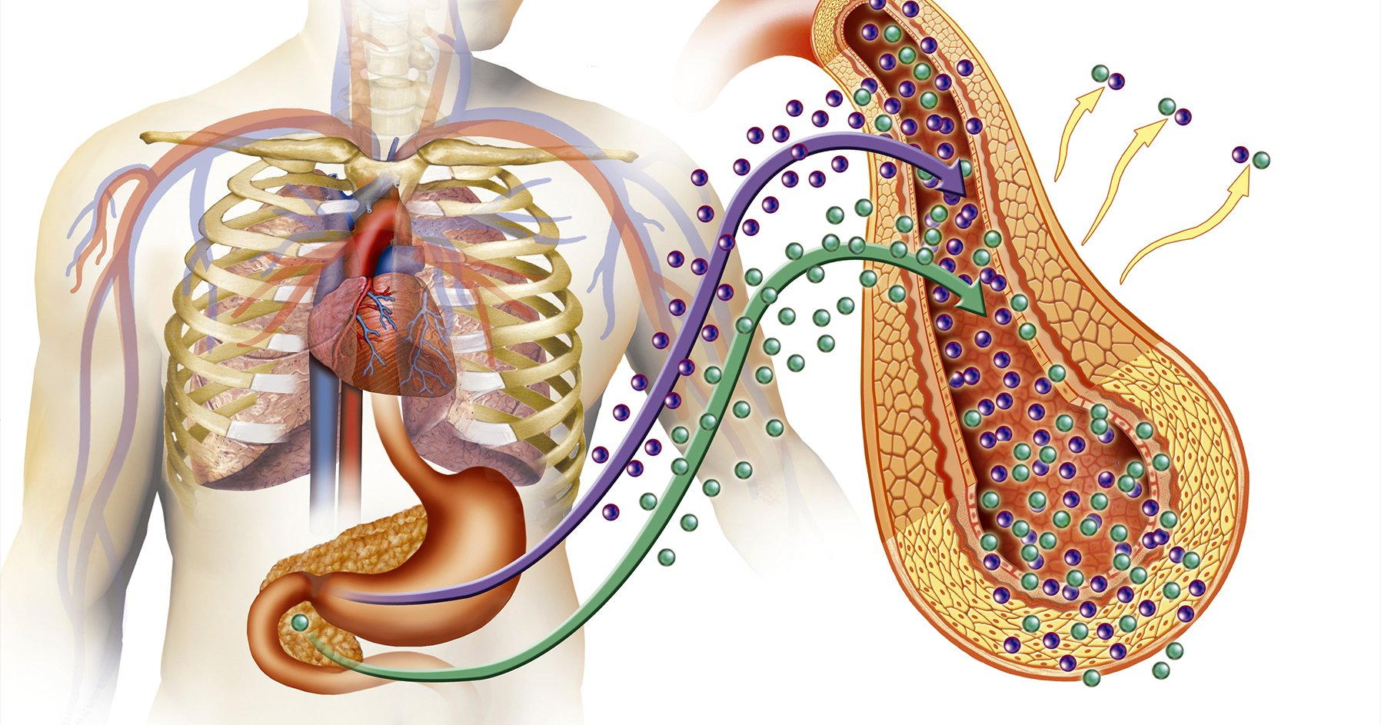
Problem and Background
Goal of my project is to create a model that can predict whether an individual has diabetes based on several input factors.
Diabetes is a group of dangerous and potentially deadly health conditions that affects how your body turns food into energy.
With diabetes, your body does not make enough insulin or can not use it as well as it should, which can lead to heart disease, vision loss, and kidney disease.
About 1 in 10 Americans have diabetes, and 1 in 5 people with diabetes do not know they have it (CDC, 2022).

Slide 3
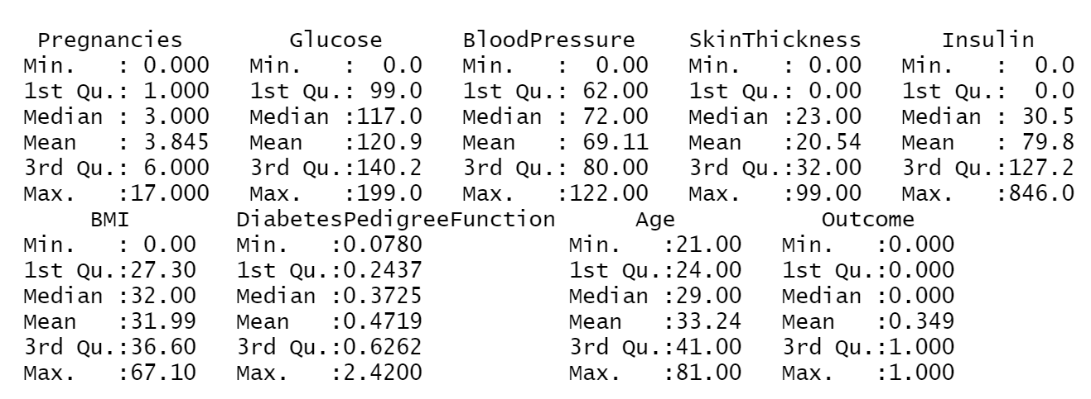
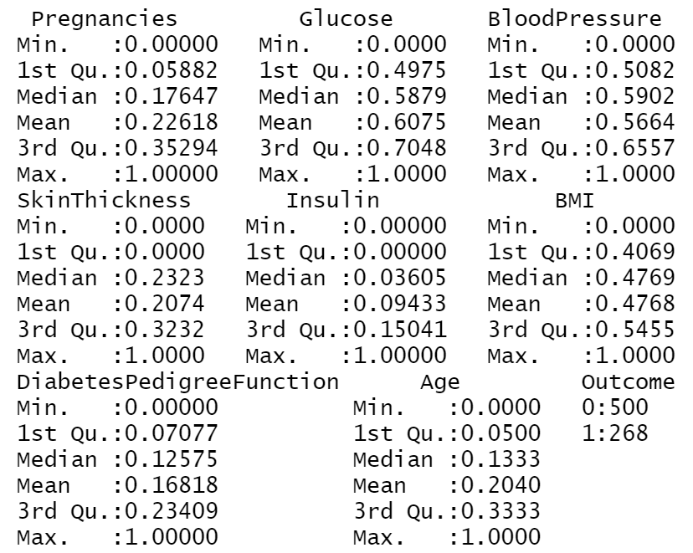
Data Description
Pre-Normalization
Normalized (min-max, preProcess()/predict())
Dataset features 768 observations in which case an individual has diabetes or does not have diabetes (1 or 0 respectively in “Outcome”), based on several possible indicators.

Slide 4
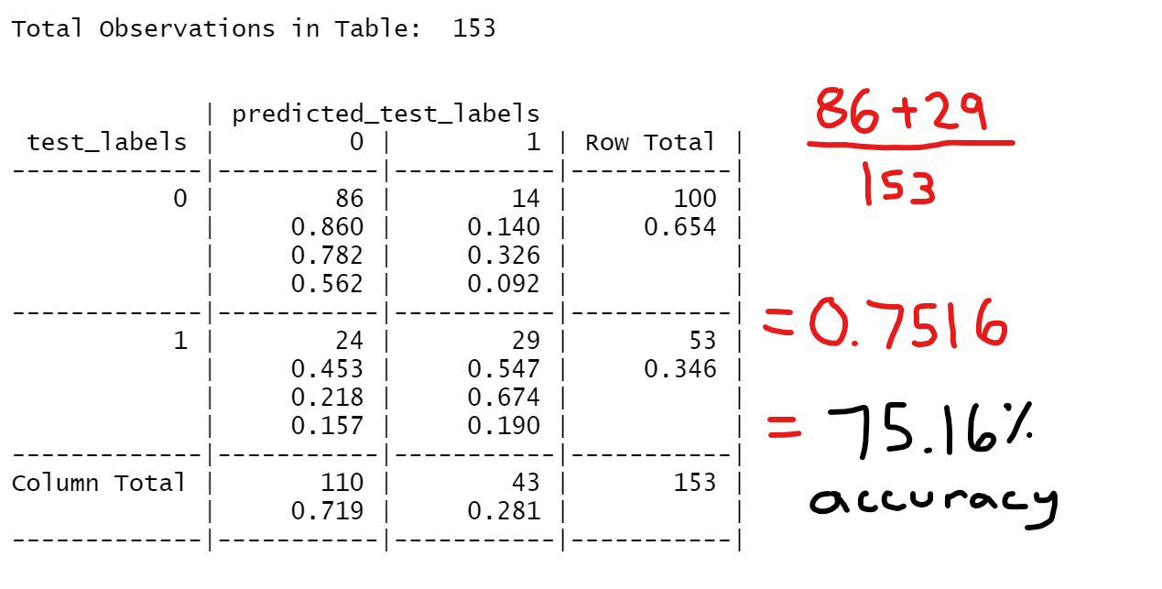
Analysis
In order to provide a solution for the problem, I used kNN (k-Nearest Neighbors) to create a predictive model that can solve for the variable Outcome—whether an individual has diabetes based on the other 8 variables.

Slide 5
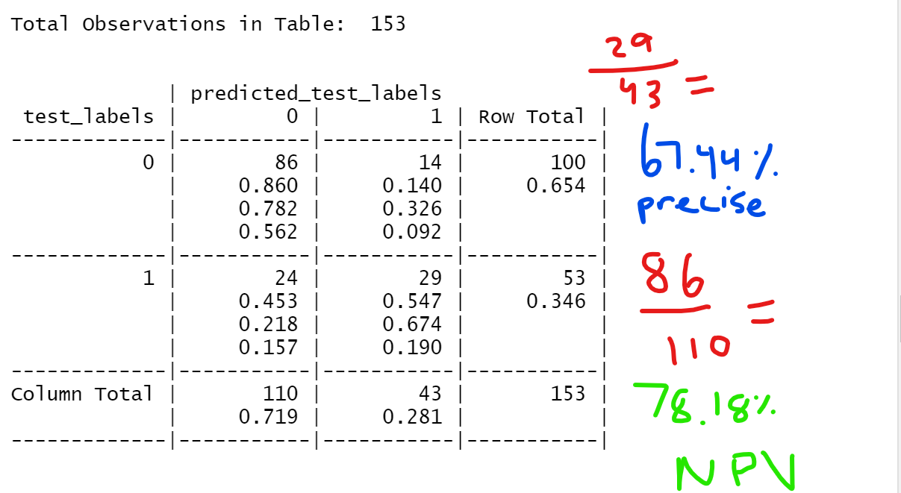
Analysis Continued (from presentation comments in class)

Slide 6
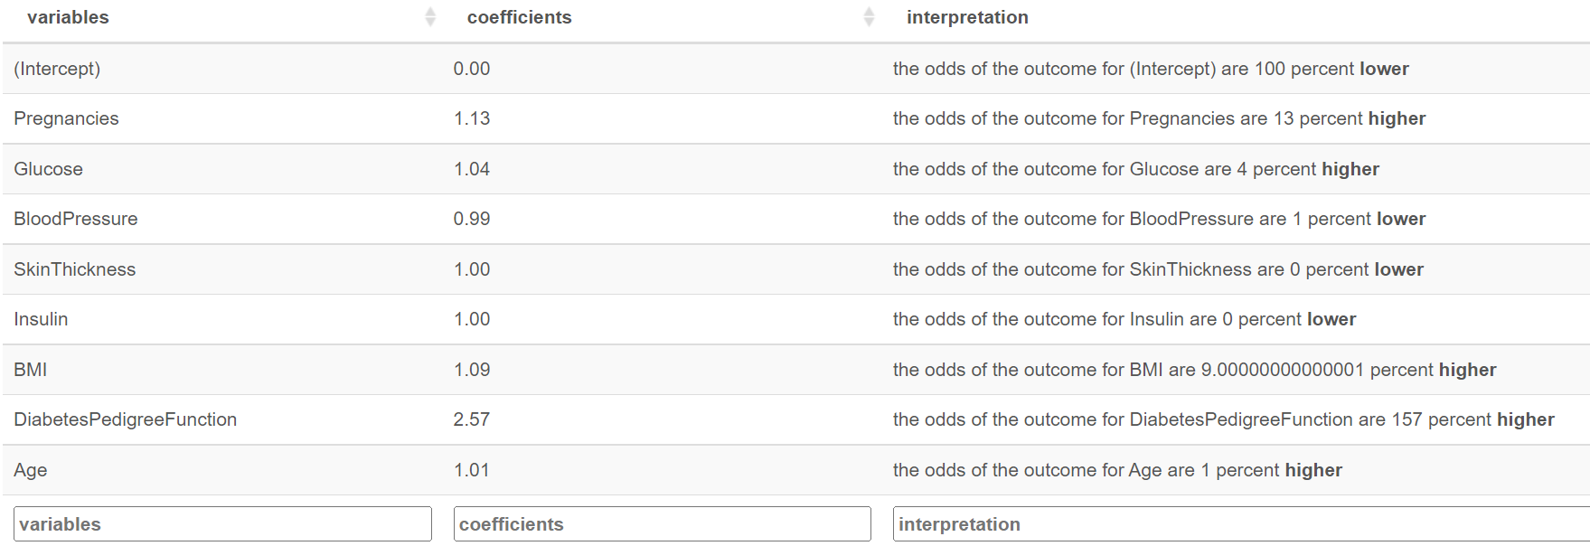
Analysis Continued
In order to discover which variables in this dataset had the greatest affect on outcome, I used logistic regression to get a better understanding.
Diabetes Pedigree Function- indicates likelihood of diabetes based on family history.

Slide 7
Conclusions/Summary
kNN predictive model offers a way for concerned individuals to test the odds of being a diabetic depending on the variables they input with an accuracy of slightly over 75%.
Based on logistic regression output, individuals should be aware that the top 3 variables in this study that increase the odds of diabetes are: BMI, Pregnancies, and Diabetes Pedigree Function.
Because of this, individuals concerned about becoming diabetic should aim to keep a low BMI (healthy height/weight proportion) and complete a Diabetes Pedigree Function test at their doctor to become aware of their family/genetic history of diabetes.

